Slide 1
Health Cart Management System
Presented By
K.S.Prasanna Kumar

Slide 2
Abstract
The "Health Cart" application project is a comprehensive solution designed to assist users in effectively managing their healthcare needs. The application aims to provide a seamless experience for users in accessing essential health-related information and services. One of the key functionalities of the application is its ability to offer access to comprehensive checkup details. Users can retrieve detailed information about various medical checkup packages available. Additionally, the application facilitates easy access to information about doctors categorized by their specific fields. This feature enables users to find doctors who specialize in their specific medical needs. By integrating a booking system, users can conveniently schedule appointments based on their own preferences. To ensure efficient management of booked activities, the application incorporates a cart feature. Through this feature, users can keep track of their purchased checkup packages and booked appointments in a centralized location. This enables users to have a clear overview of their upcoming medical commitments and previously availed services. Recognizing the importance of data security, the project includes a login page and a dedicated login database. This ensures that user information is protected and accessed securely.

Slide 3
System Analysis
Existing System
Several applications exist that allow users to book appointments, but they are often limited to specific doctors or hospitals. Users need to install separate apps for each doctor or hospital they wish to book an appointment with, resulting in a fragmented and cumbersome booking experience.
The existing system lacks a comprehensive application that provides a consolidated list of doctors based on their medical specialty. Users may have to rely on multiple sources or platforms to gather information about doctors in different specialties, making the search process time-consuming and inefficient.
Addressing these limitations can lead to the development of an improved system that offers a more efficient and user-friendly experience for users seeking doctor information and appointment booking services.

Slide 4
Proposed System
The proposed system will provide a comprehensive list of doctors based on their medical specialty. Users can easily search and browse through the list to find doctors in their desired field, eliminating the need to rely on multiple sources or applications.
The proposed system will allow users to book appointments with specific doctors from the list based on their specialty. Users can select a doctor of their choice and choose an available time slot for the appointment, ensuring a convenient and personalized booking experience.
The proposed system will prioritize a user-friendly interface that is easy to navigate and provides a seamless experience. Users will be able to access the desired information, book appointments, browse articles, and interact with the application effortlessly.

Slide 5
Hardware and Software Requirement
Hardware Requirement
Software Requirement
Frontend:
XML
Backend:
Java
SQLite
Android mobile with Lollipop (5.0) and above versions
Minimum of 2 GB of RAM or More.
Minimum of 512MB of available storage.

Slide 6
Modules
Login page
Checkup packages
Find doctors
Doctor’s specialty
Health articles

Slide 7
Module Description
Login Page:
The Login Page module is an essential component of an Android application that provides a secure and user-friendly way for users to access the app. Its main functionality revolves around user authentication and registration. The Login Page allows new users to register by providing their necessary details such as username, email address, and password. Input validation ensures that the provided information meets the specified criteria
Checkup Packages Page:
The Checkup Packages module is a feature within an Android application that allows users to browse and select checkup packages from a variety of health checkup packages. The module facilitates a seamless process for users to add their desired package to a cart and proceed to checkout.

Slide 8
Find Doctors Page:
The Find Doctors module aims to simplify the process of searching and booking appointments with doctors. It provides users with the ability to search for doctors based on specialties, view detailed profiles, and conveniently book appointments. The integration with backend systems ensures accurate and up-to-date information improves the overall user experience.
Health Articles Page:
The Health Articles module is a valuable component that offers users to access a collection of health-related articles. This module provides a platform for users to explore informative and educational content related to various health topics. This module aims to provide users with a valuable resource for accessing reliable and informative health-related content. The module enhances users knowledge and promotes health awareness.

Slide 9
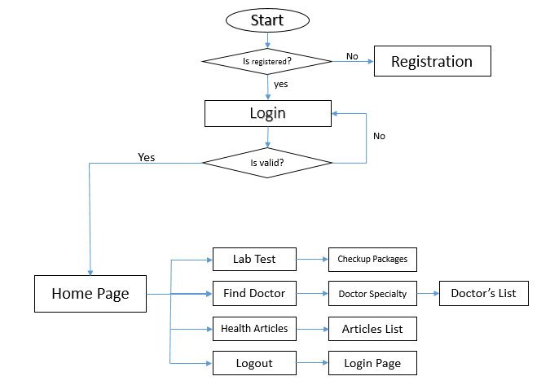
System Design

Slide 10
Database Design
Cart Table:
Users Table:
Sl.no | Name | Type | Constraints
1 | Username | Text | Primary key
2 | Email | Text | Not Null
3 | Password | Text | Not Null
Sl.no | Name | Type | Constraints
1 | Username | Text | Foreign key References users(Username)
2 | Product | Text | Not Null
3 | Price | Float | Not Null
4 | Otype | Text | Not Null

Slide 11
Orderplaced Table:
Healthcare View:
Sl.no | Name | Type | Constraints
1 | Username | Text | Foreign key References users(Username)
2 | Fullname | Text | Not Null
3 | Address | Text | Not Null
4 | Contactno | Text | Not Null
5 | Pincode | Int | Not Null
6 | Date | Text | Not Null
7 | Time | Text | Not Null
8 | Amount | Float | Not Null
9 | Otype | Float | Not Null
Sl.no | Name | Type | Constraints
1 | Username | Text | From users(Username)
2 | Email | Text | From Users(Email)
3 | Fullname | Text | From Orderplaced(Fullname)
4 | Address | Text | From Orderplaced(Address)
5 | Contactno | Text | From Orderplaced(Contactno)
6 | Pincode | Int | From Orderplaced(Pincode)
7 | Date | Text | From Orderplaced(Date)
8 | Time | Text | From Orderplaced(Time)
9 | Amount | Text | From Orderplaced(Amount)
10 | Otype | Text | From Orderplaced(Otype)

Slide 12
System Testing
System testing is the testing of the behavior of a complete and fully integrated software product based on the software requirements specification (SRS) document. System Testing is a crucial phase in the software development life cycle (SDLC) that focuses on evaluating the complete and integrated system to ensure that it meets the specified requirements and functions as expected. It involves testing the system as a whole rather than individual components or units.
Unit Testing
This type of testing focuses on testing individual units or components of the application, such as methods or classes. Unit tests help identify bugs and ensure that each unit of code works as intended.
Integration Testing
Integration testing verifies the interaction between different modules or components of the application. It ensures that the integrated parts work together correctly and that data flows smoothly between them.

Slide 13
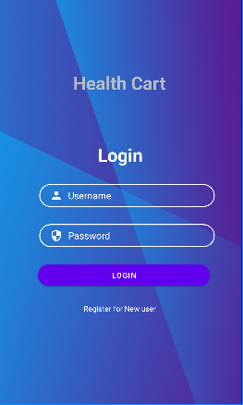
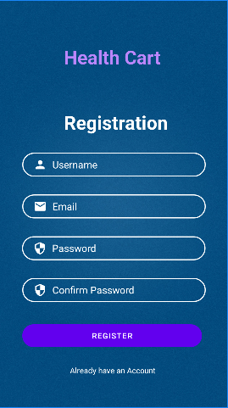
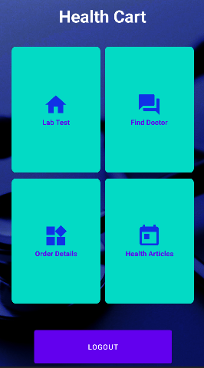
Screenshots
Login Page:
Registration Page:
Home Page:

Slide 14
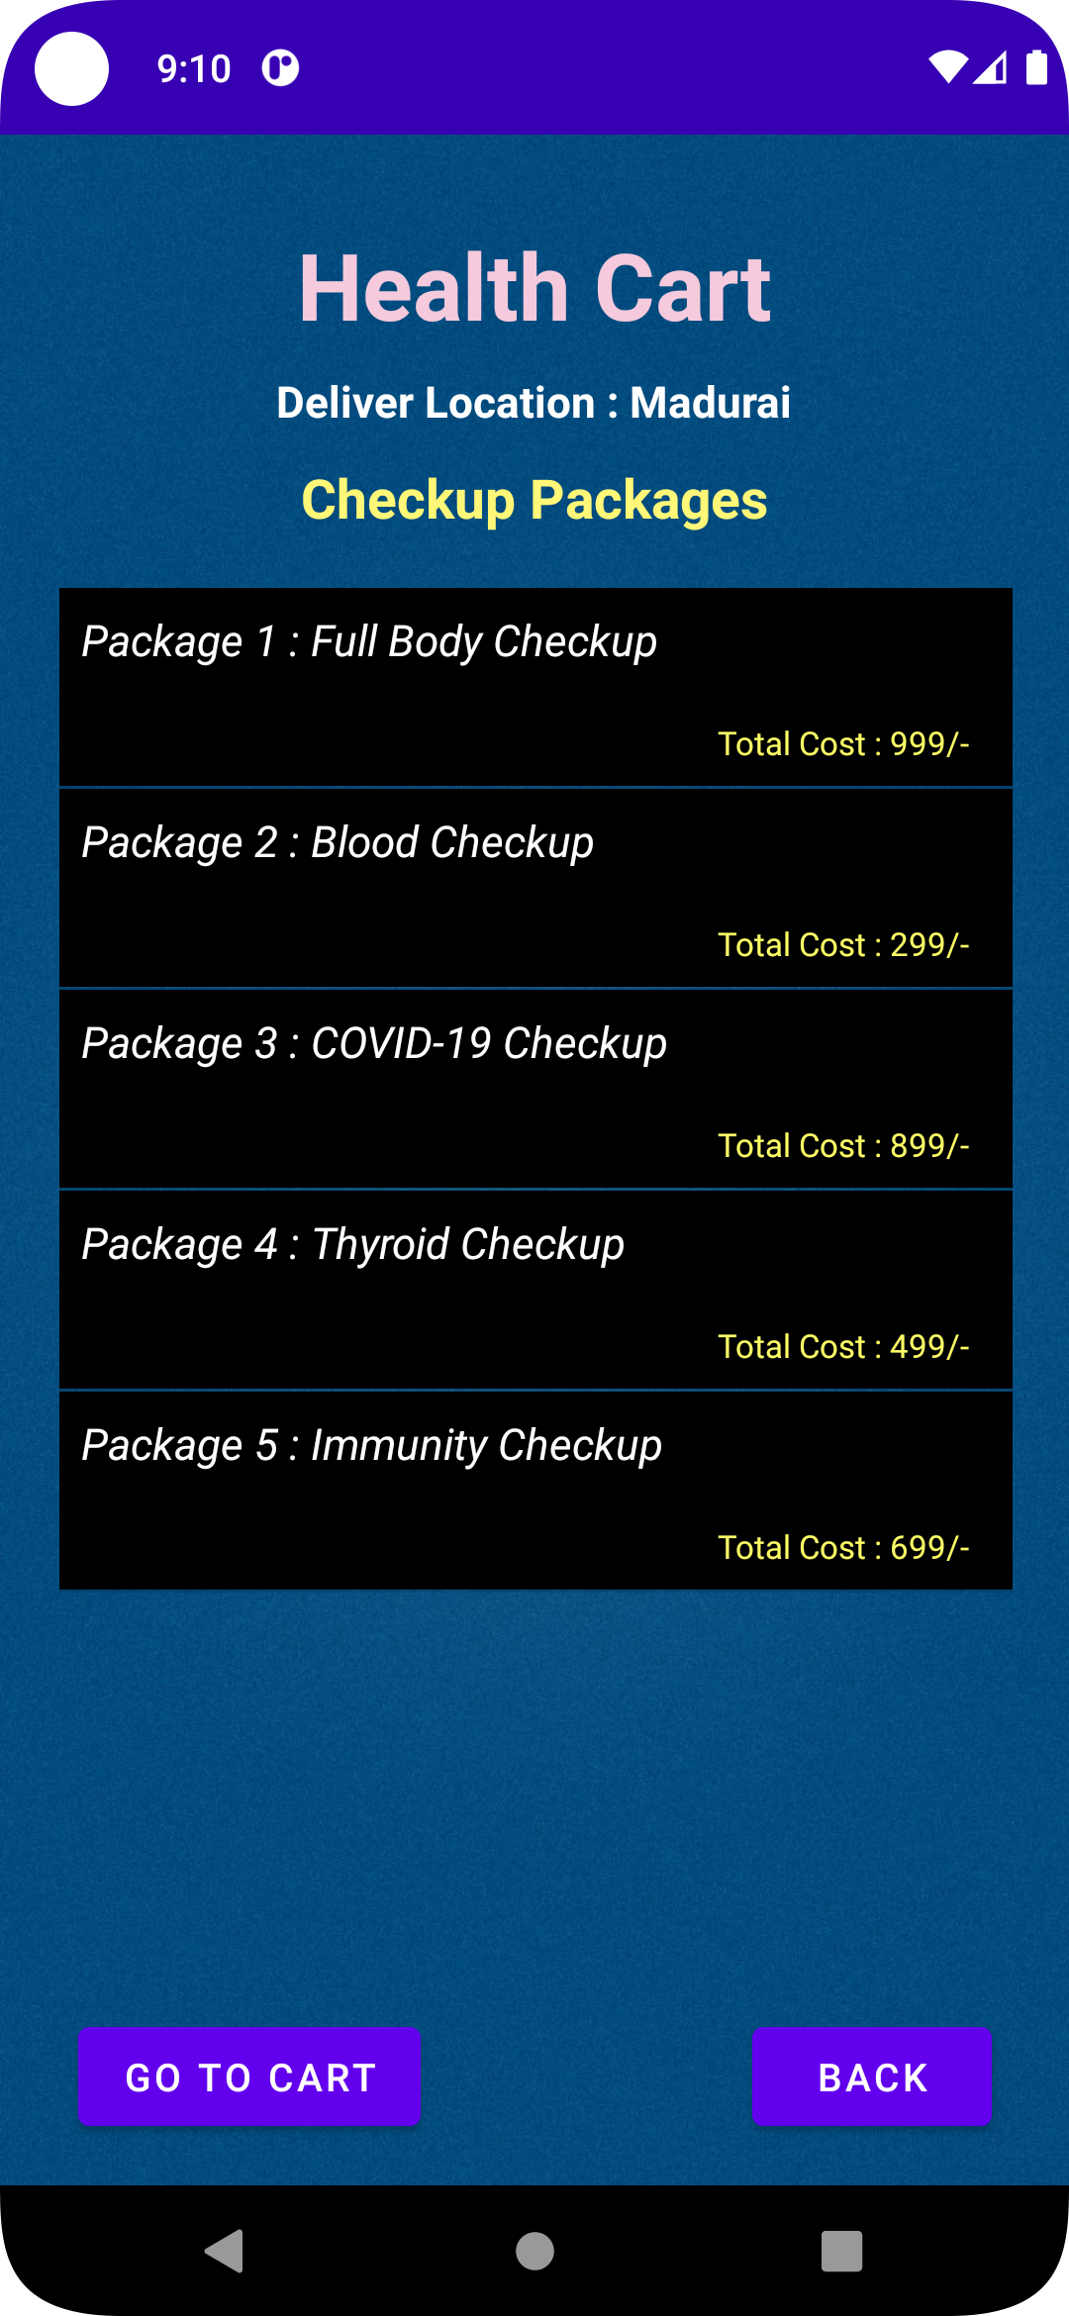
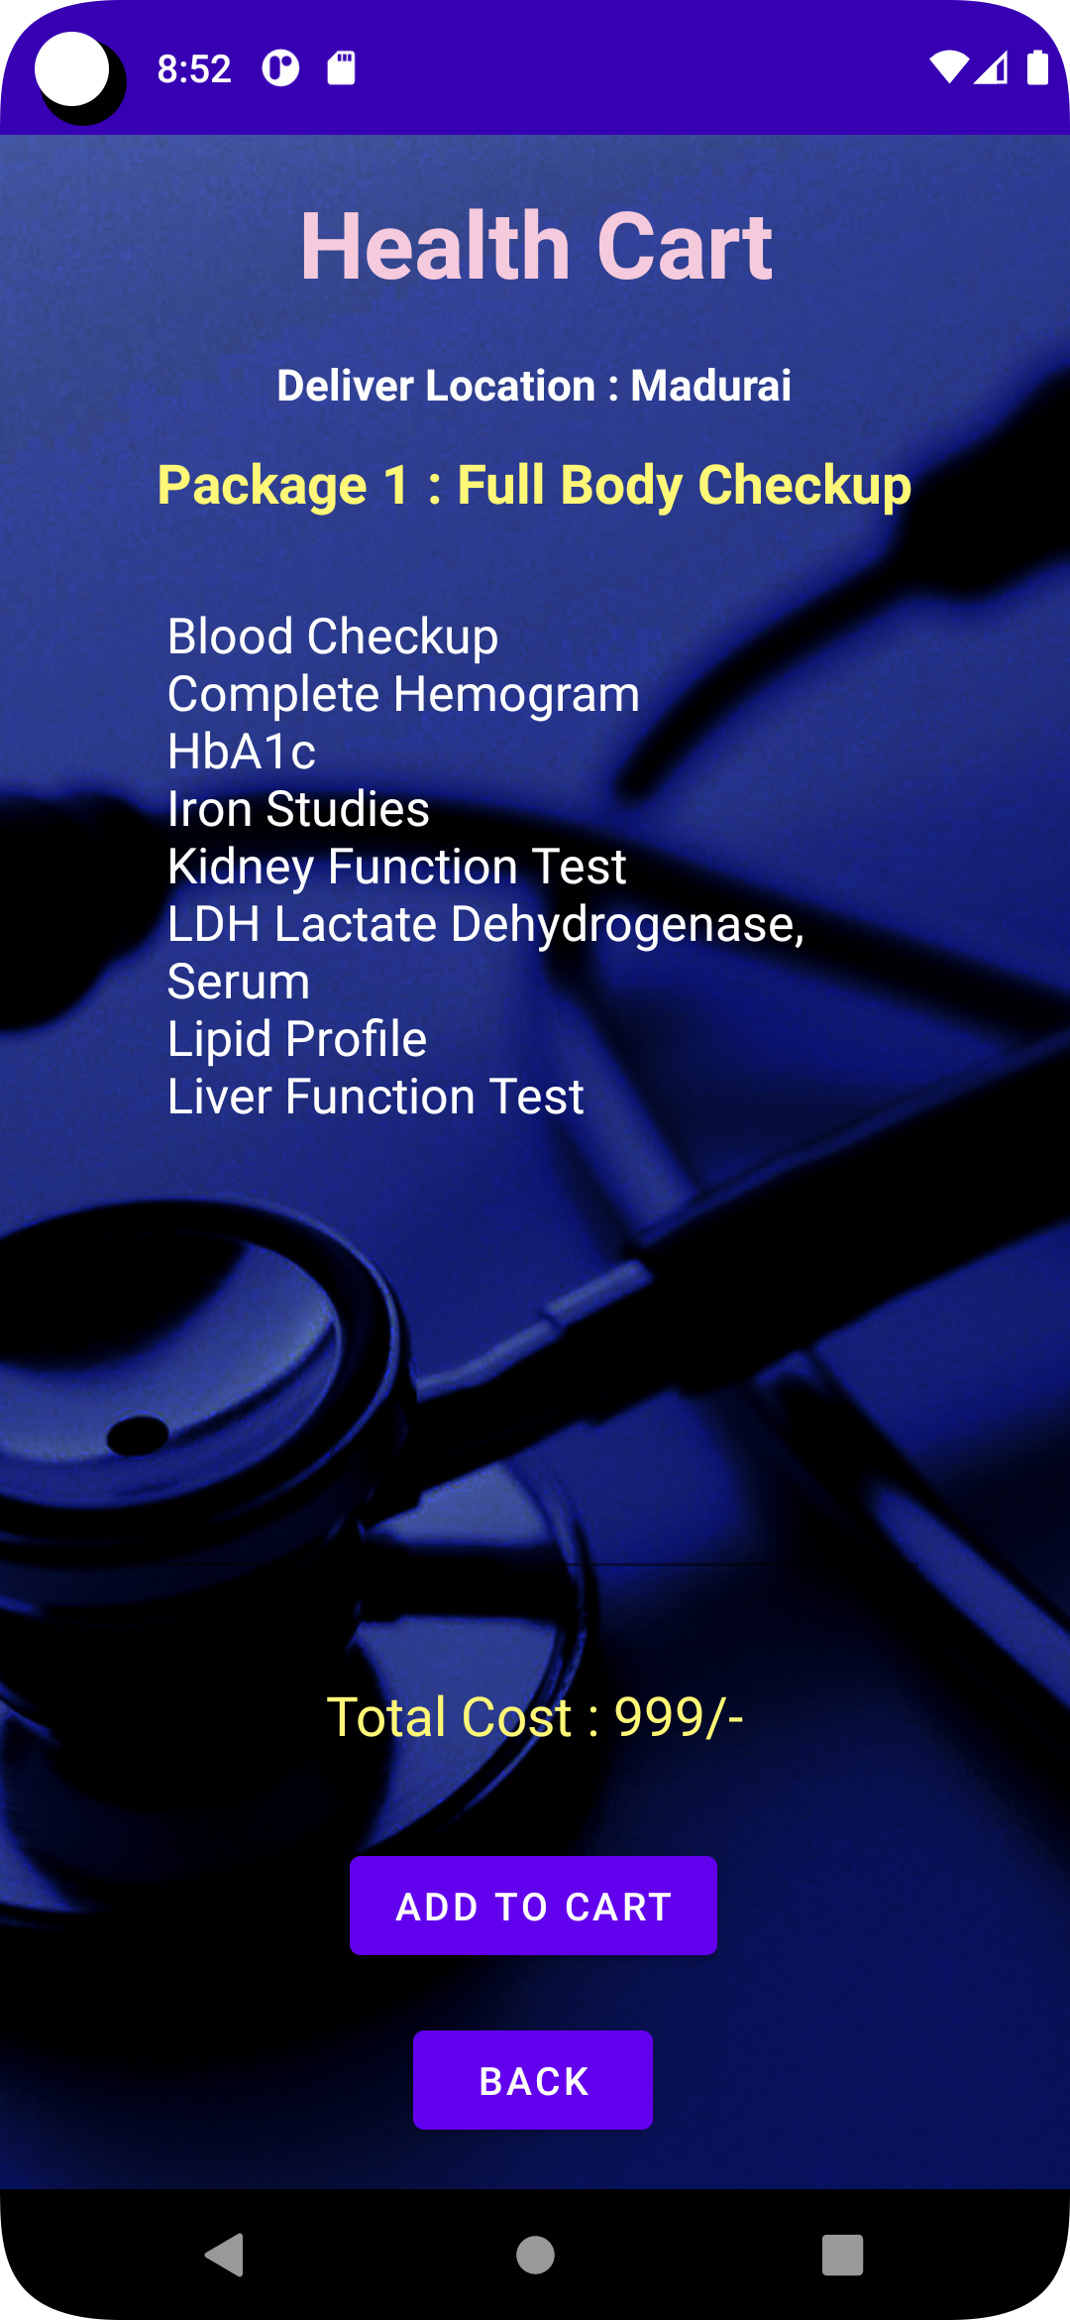
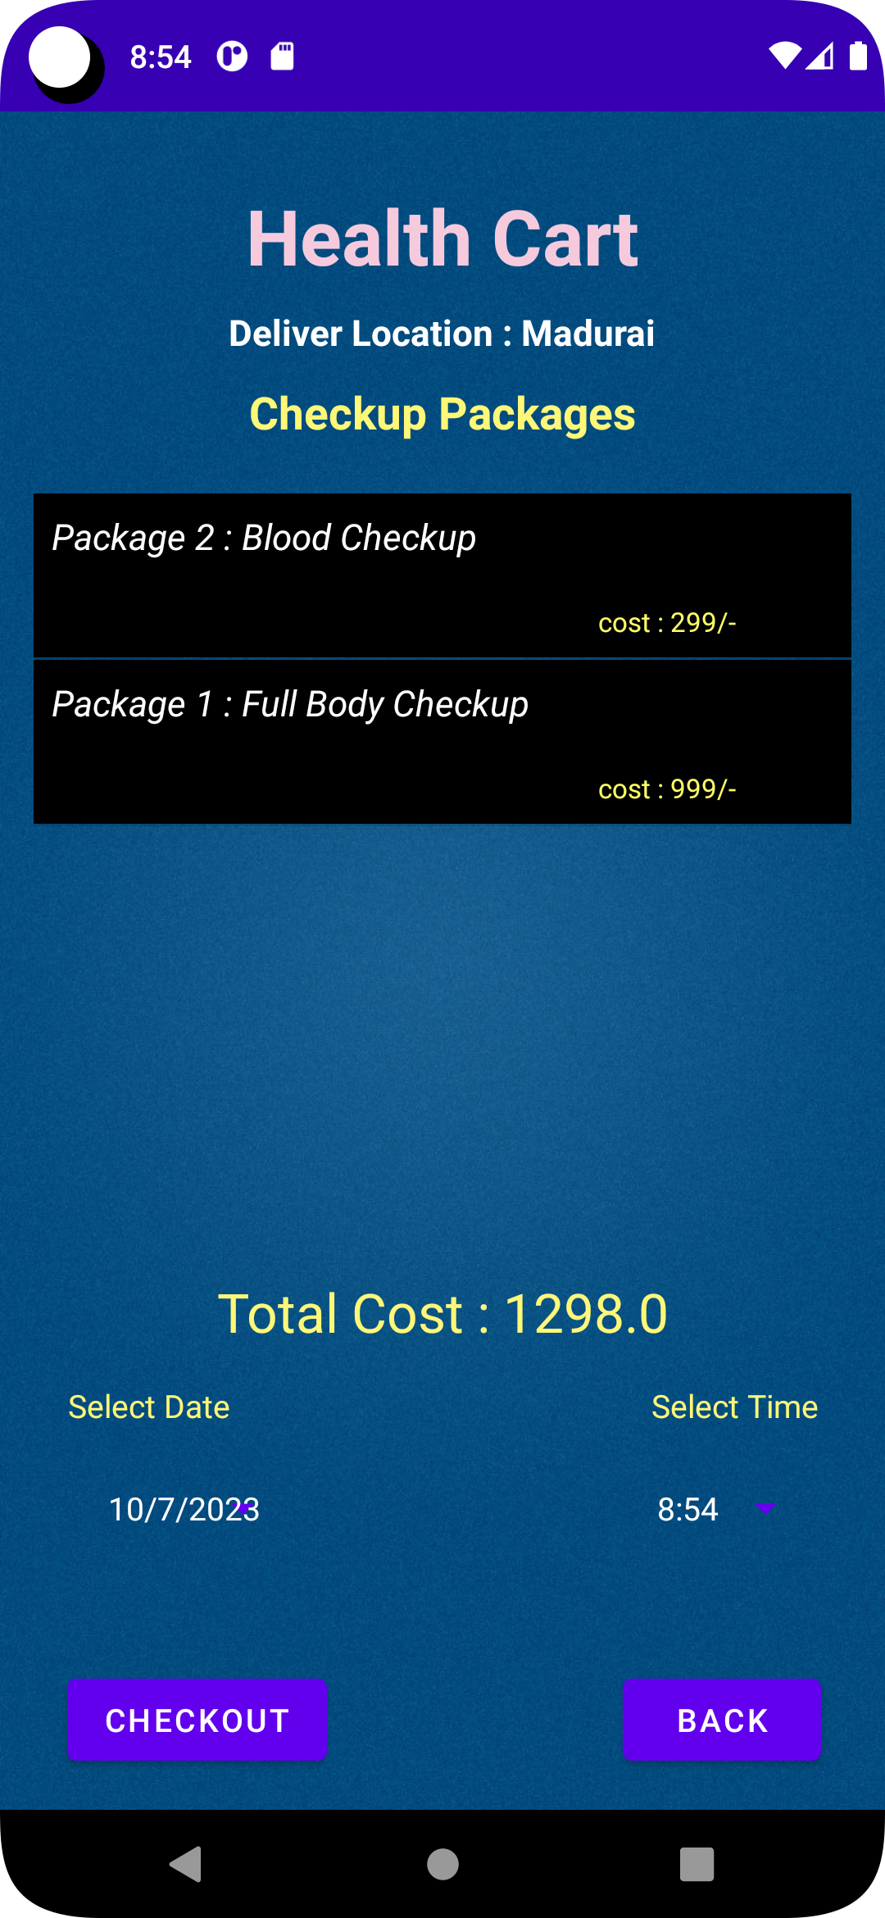
Lab Test Page:
Package Details:
Go To Cart Page:

Slide 15
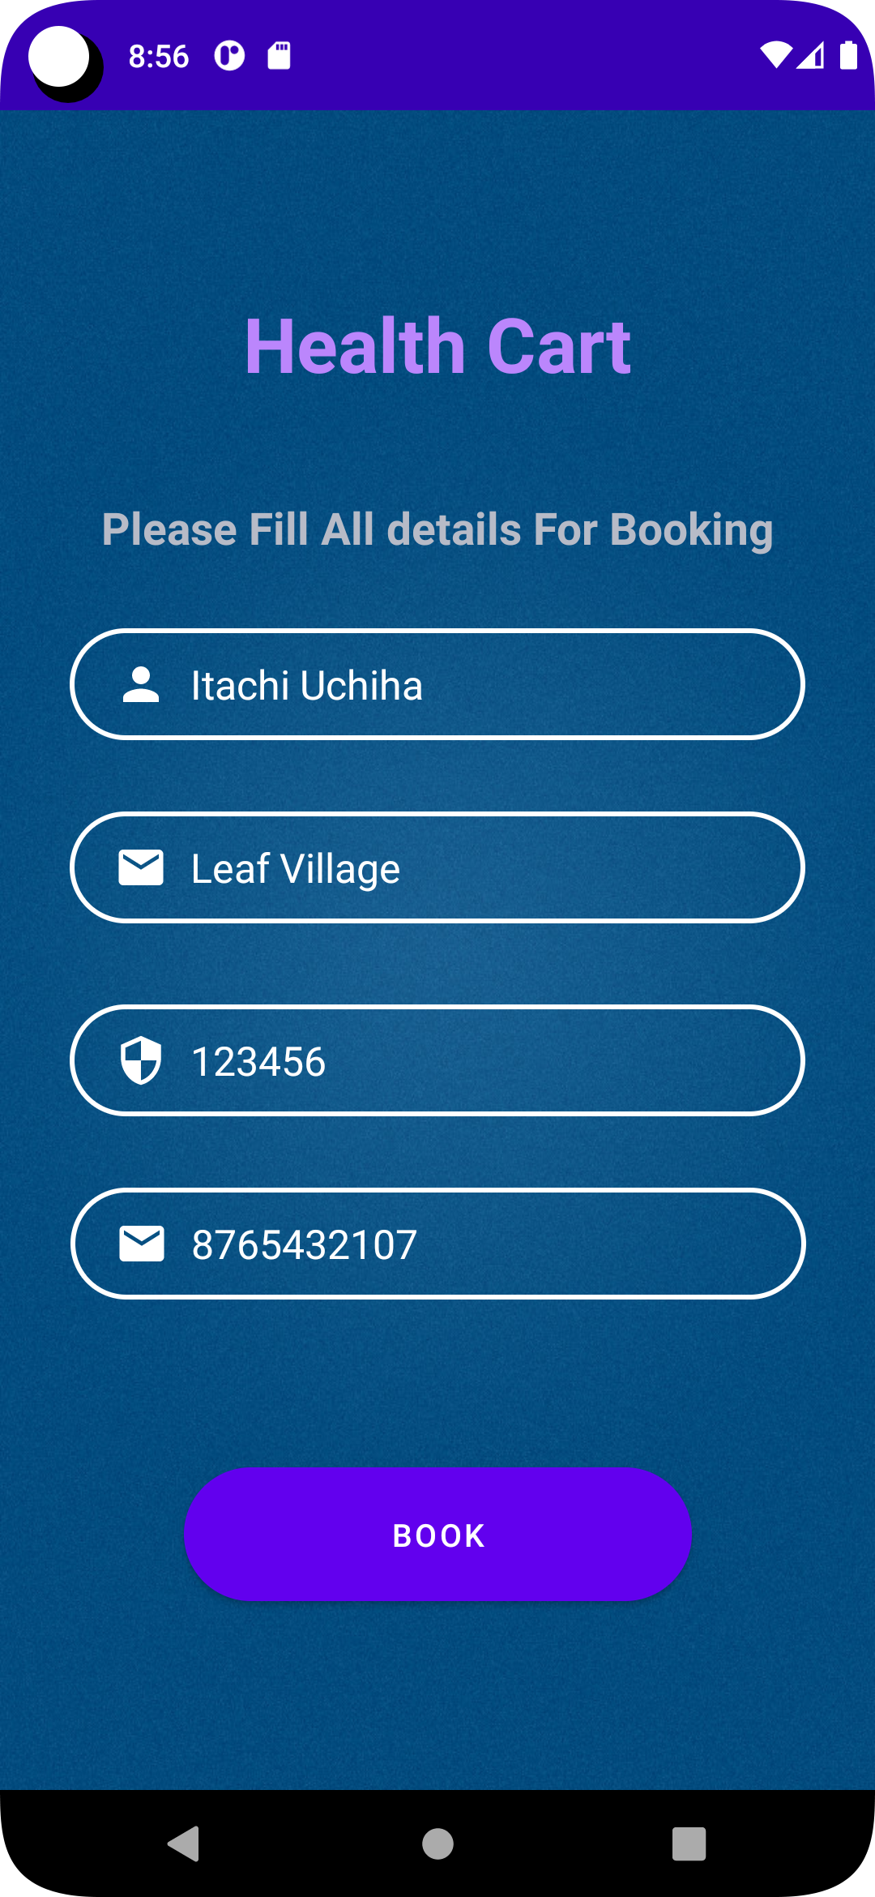
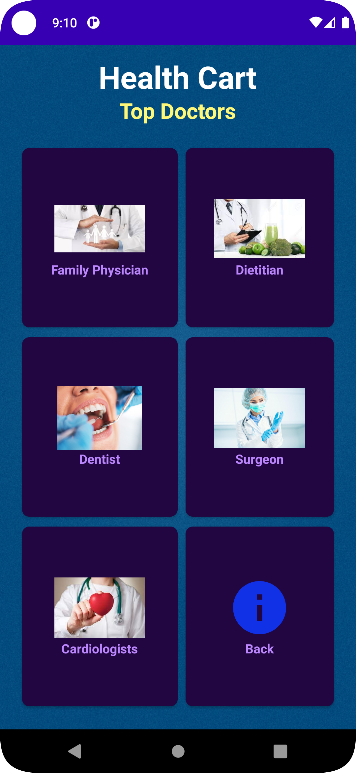
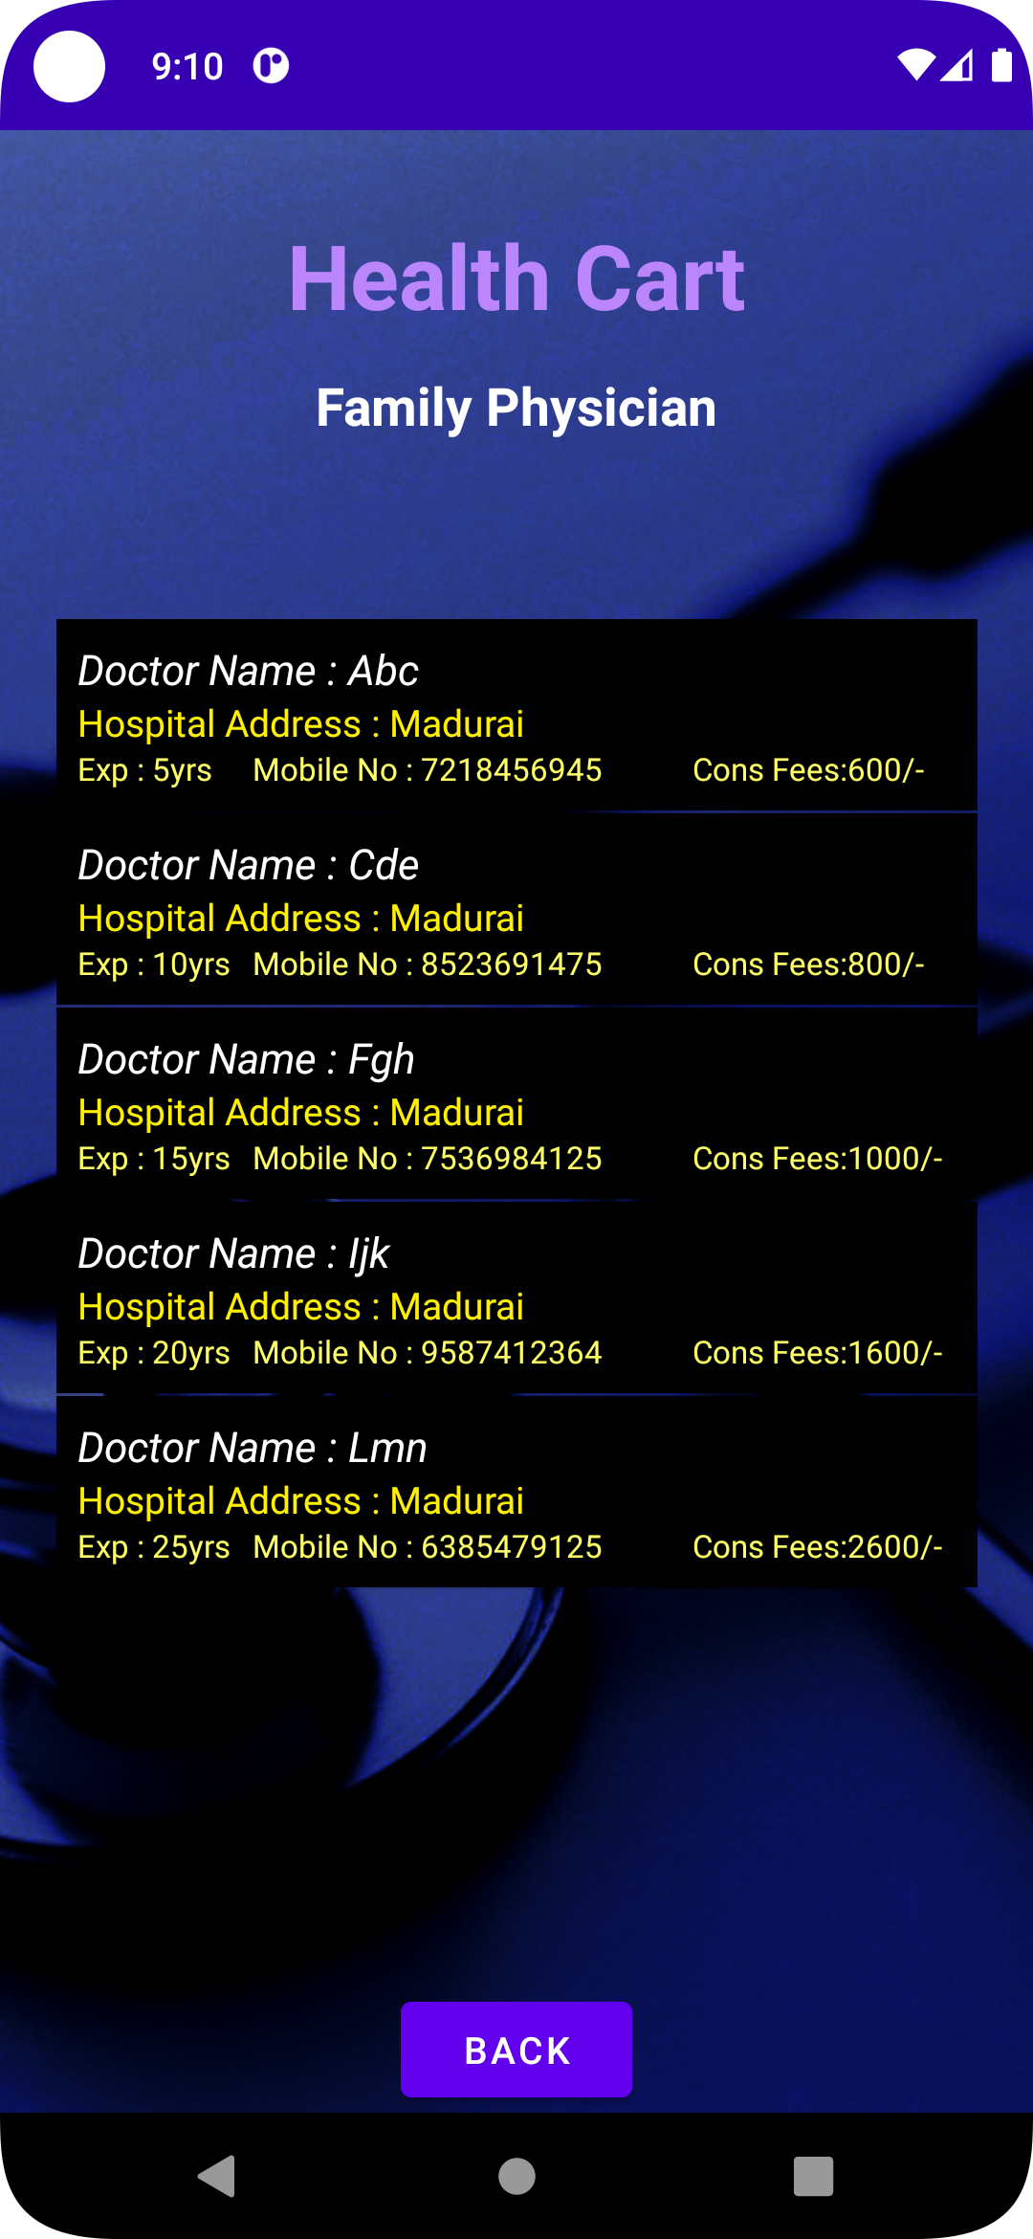
Checkout Page:
Find Doctors Page:
Doctors List:

Slide 16
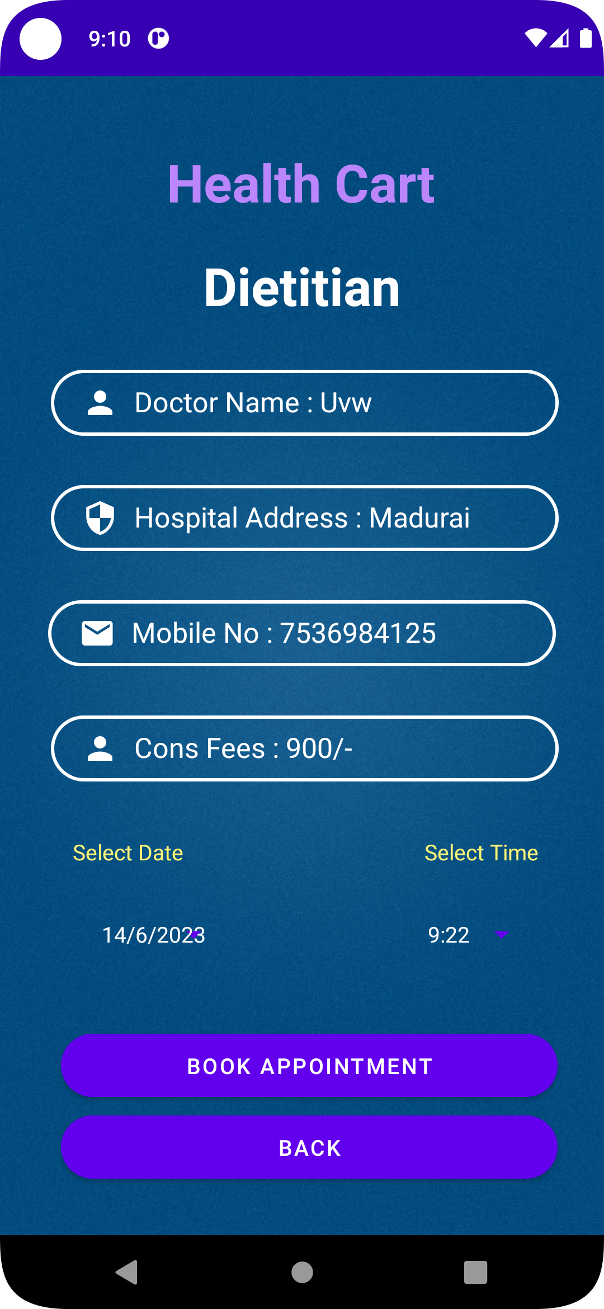
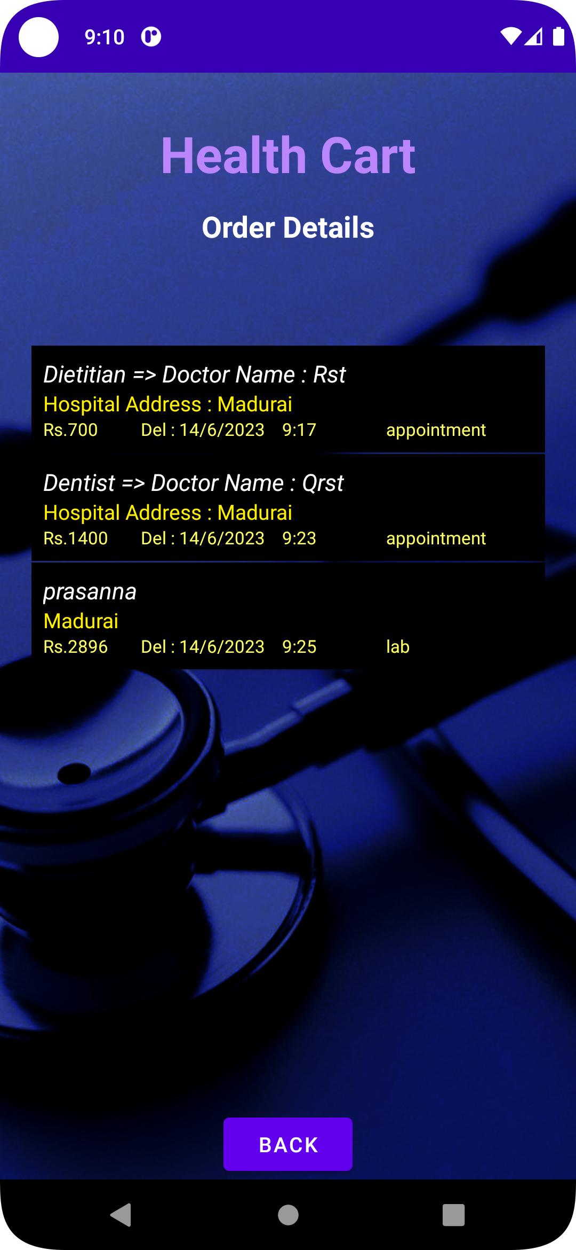
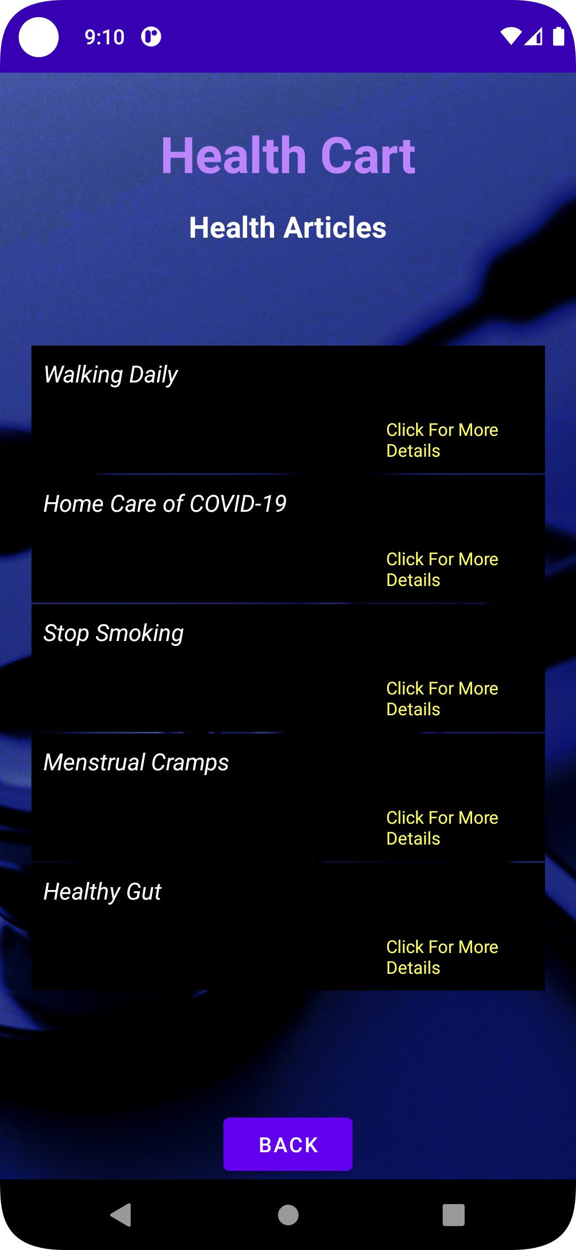
Doctor Description:
Order Details Page:
Health Articles Page:

Slide 17
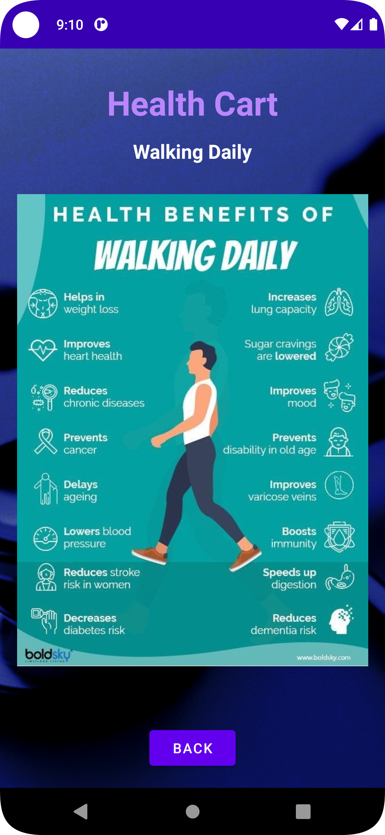
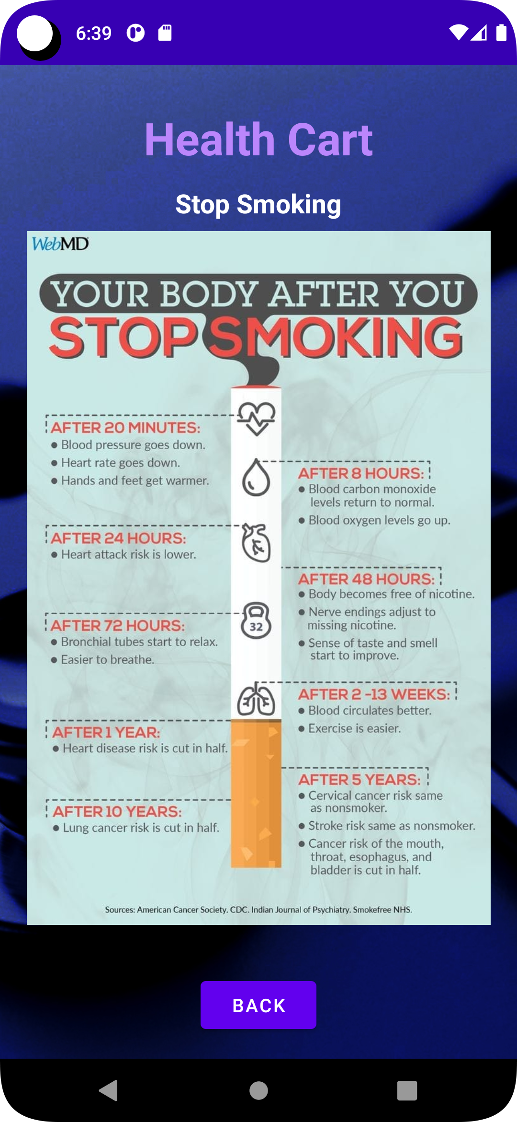
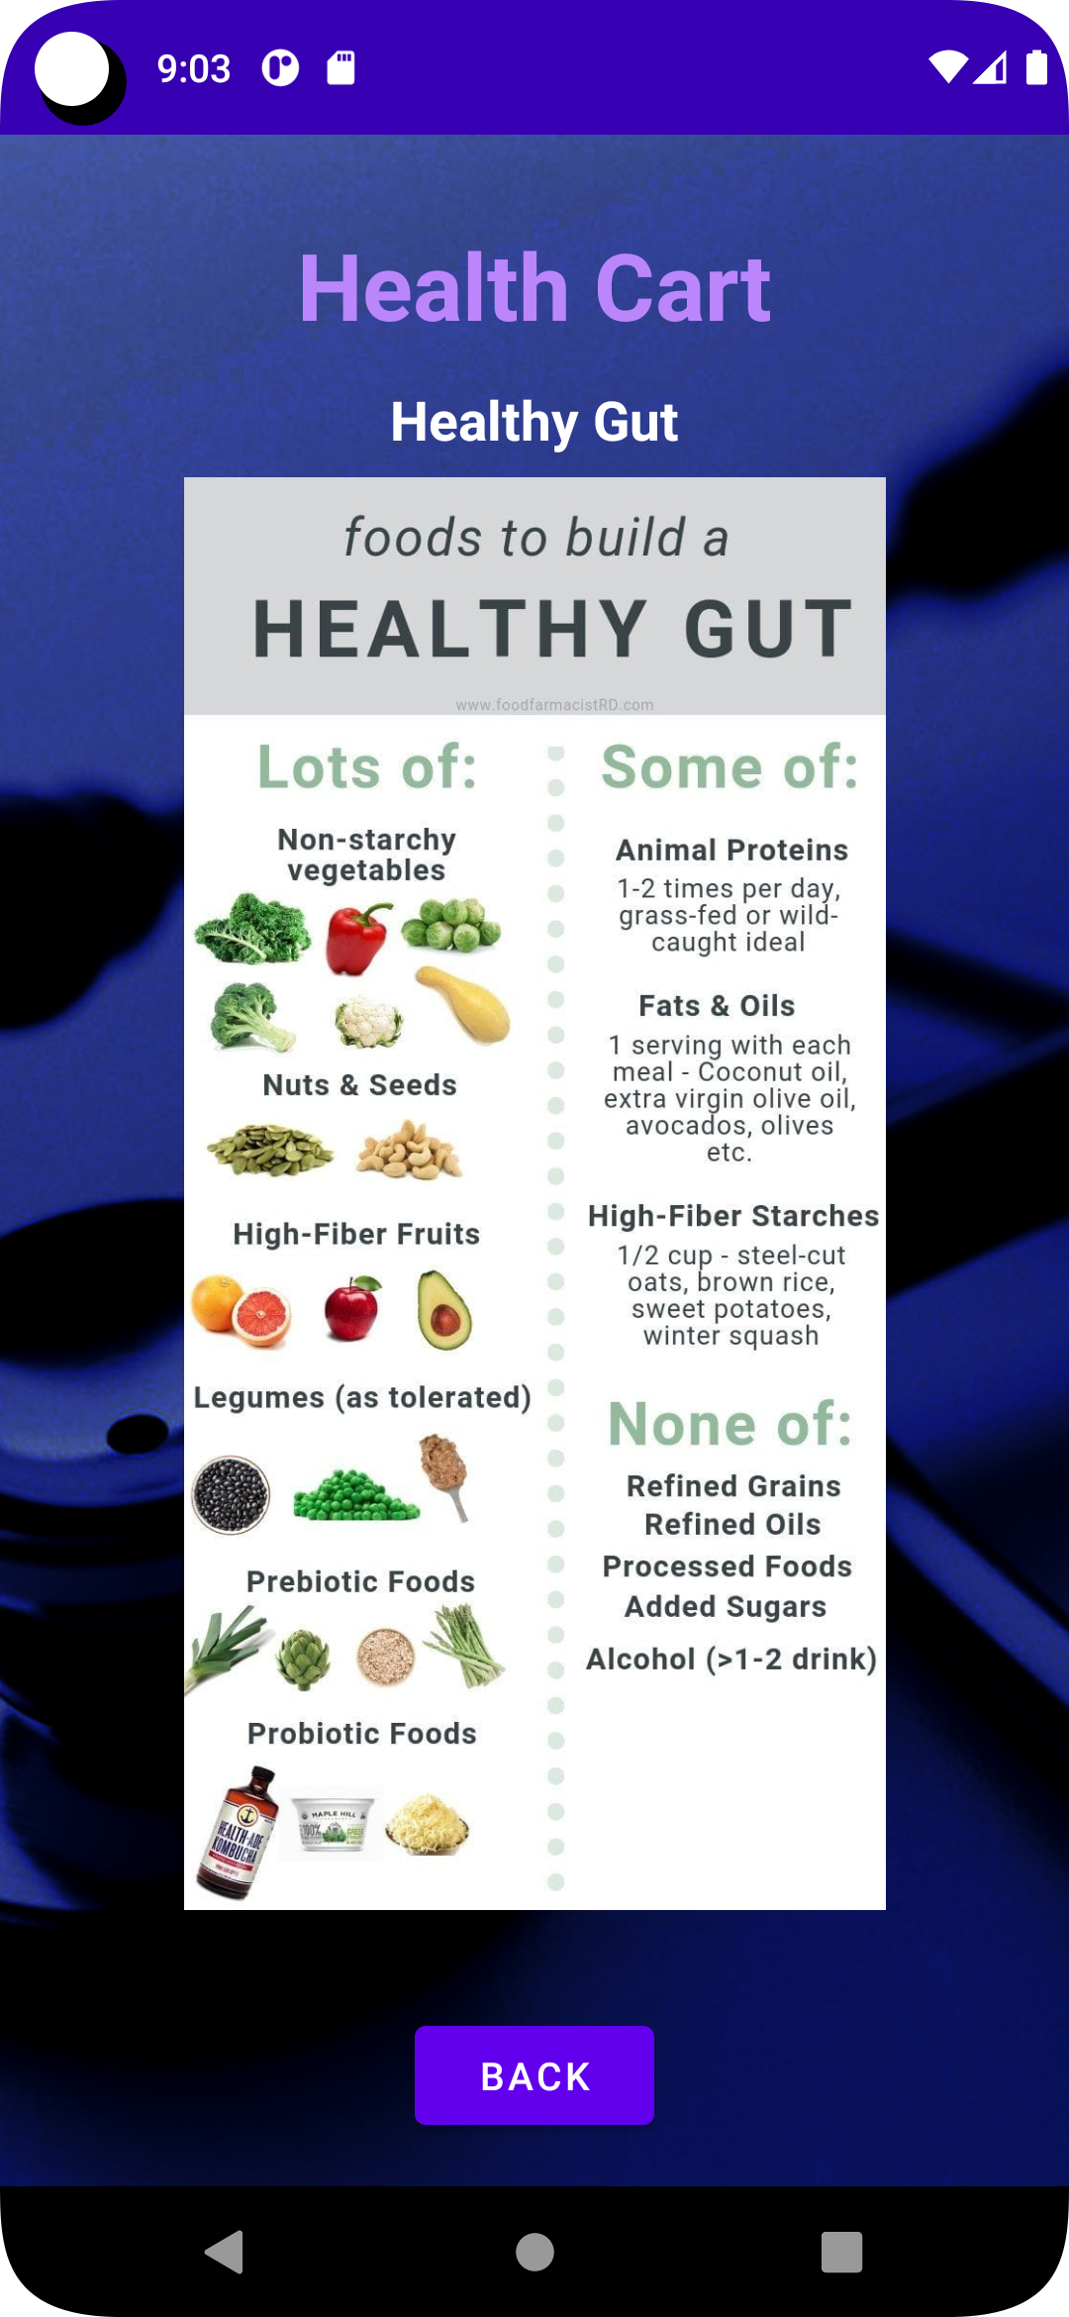
Article Contents Page:

Slide 18
Thank You

